Slide 1
Tech Challenge Walkthrough
Gokul Ramanan
Notes:
I’m going to be walking through how I approached the AeroConnect challenge, from exploring the data to building the dashboard to making the prediction model, and finally giving recommendations to AeroConnect.

Slide 2
Data Prepping
Created the following columns:
Date (year-month-01)
Route (Aus port → Foreign port)
City_pair (Aus port | Foreign port)
Load_balance_diff (passenger_in - passenger_out)
Load_balance_ratio (passenger_in / passenger_out)
Continent
Passenger_total_z (Z score of the route’s month)
Notes:
Let’s first start off by talking about how I prepped the data and got the clean CSV that I used for all my analysis. I ended up creating seven new columns to make the dataset easier to work with.
The first one was Date, where I used the year and month column to set the date of each row equal the first day of the given month in that year to make everything lines up nicely by month. Then I made a Route column, which shows the Australian port pointing to the foreign port, showing the city pair in a readable format. The City_pair is very similar to this, except the Australian and foreign port are separate with a vertical line.
Next, I created two columns around load balance. Load_balance_diff is just passengers in minus passengers out, so I could quickly see if a route had more people coming in than leaving. Then Load_balance_ratio does the same thing but as a ratio, which helps compare routes of different sizes.
I also added Continent, which groups the foreign port by its continent, so I could look at bigger geographic trends — like Asia and Oceania clearly being the busiest.
Finally, I made Passenger_total_z, which is just the z-score of the how the route performed, relative to its other months in the dataset.
These extra columns made it way easier to find patterns, run the models and visualizations I did, and set the foundation for the forecasting insights I was able to glean from later.

Slide 3
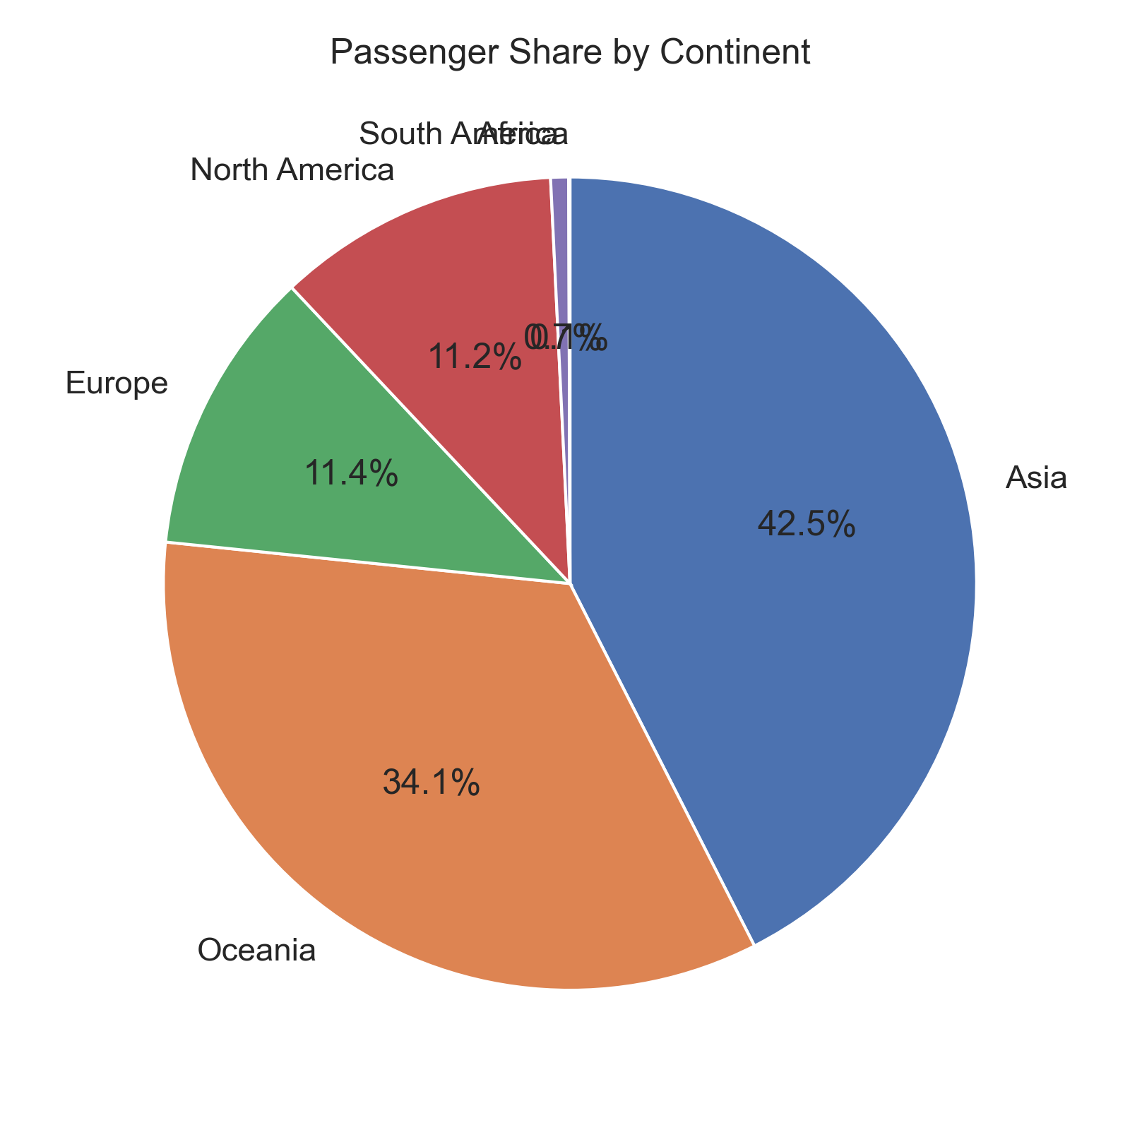
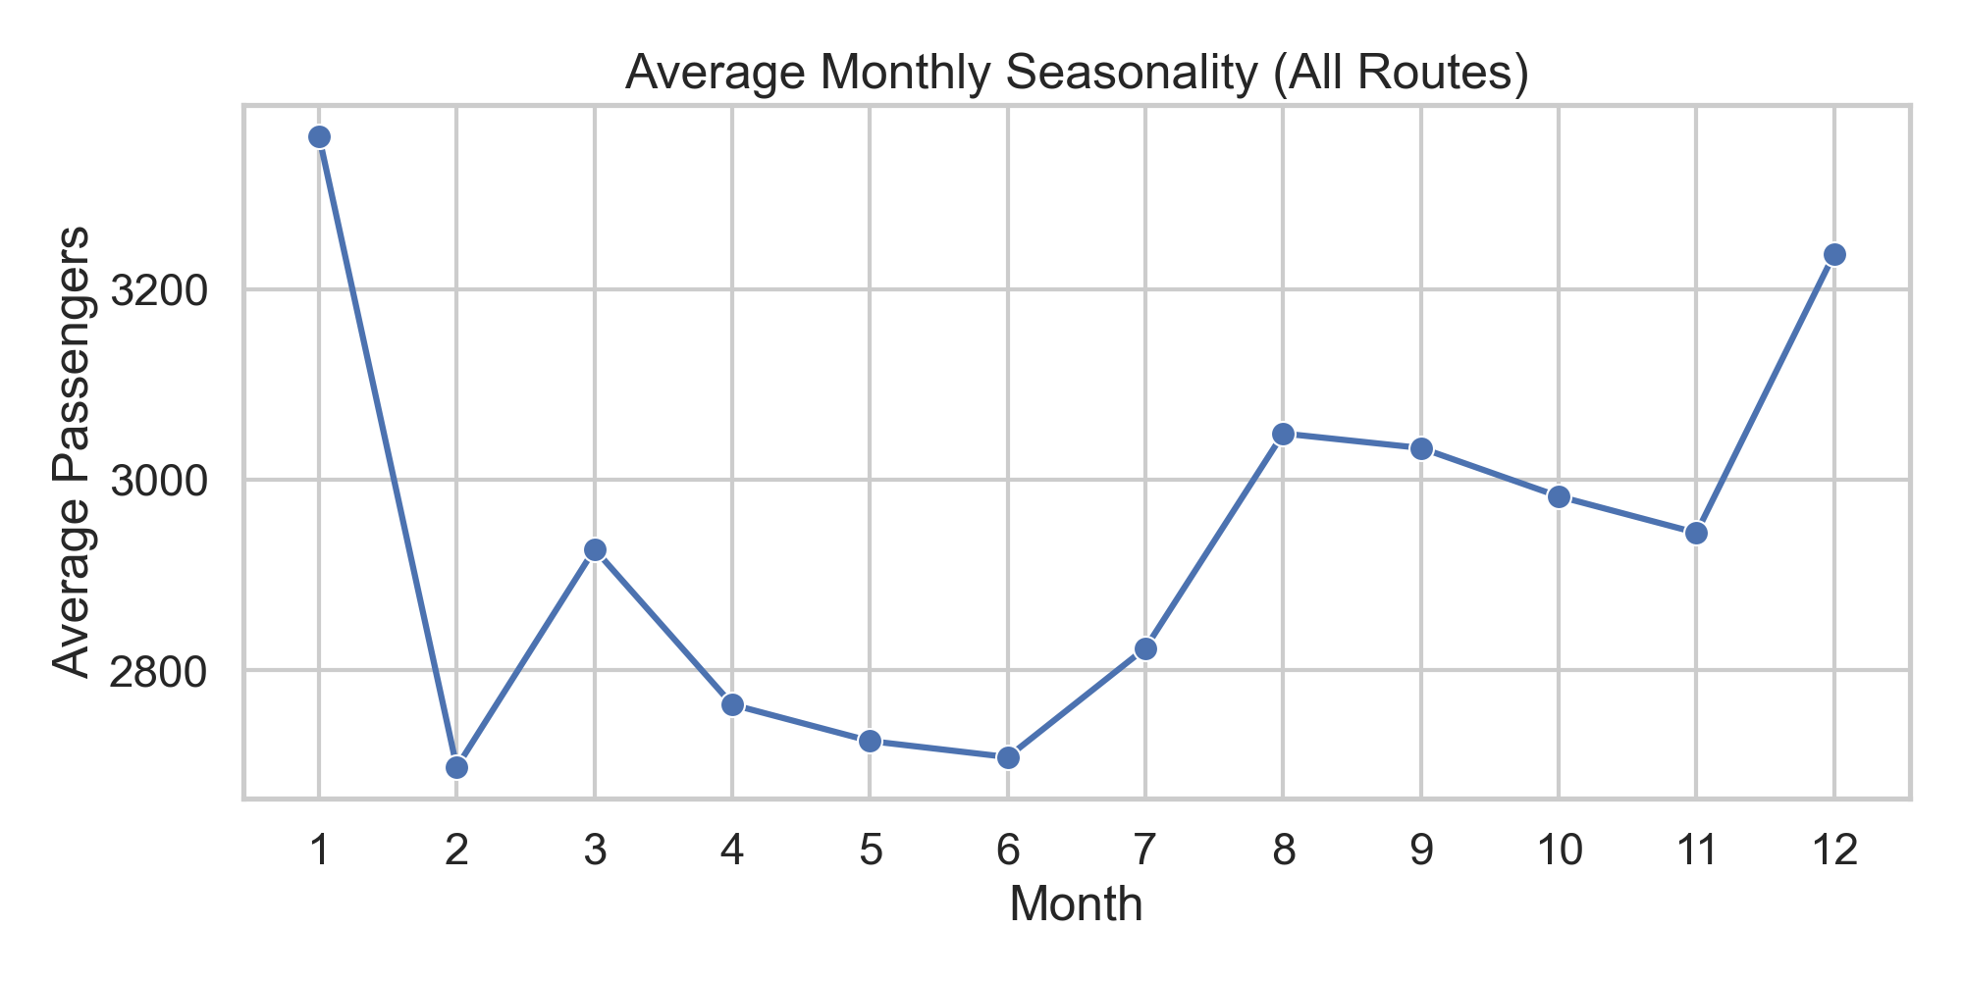
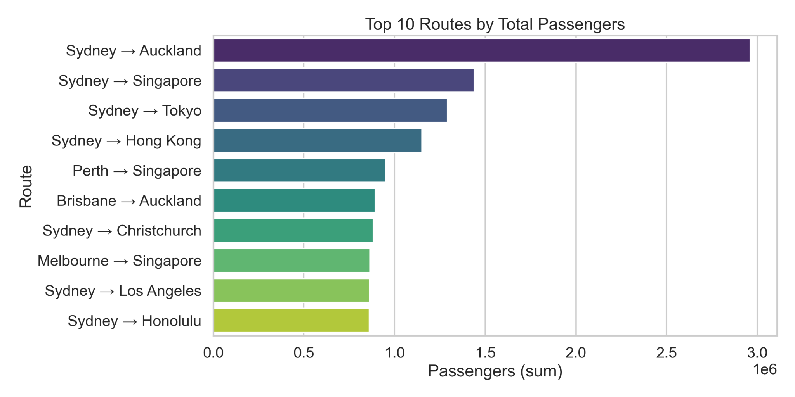
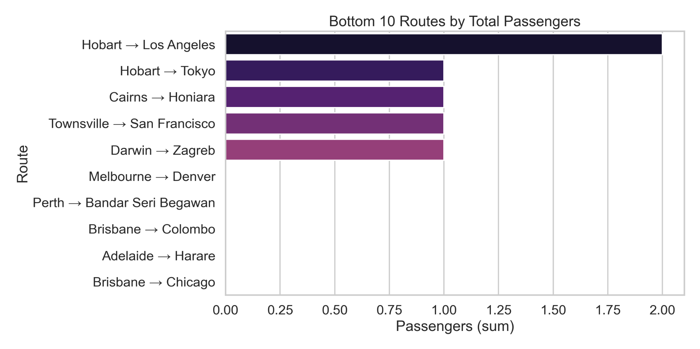
Exploratory Data Analysis

Slide 4
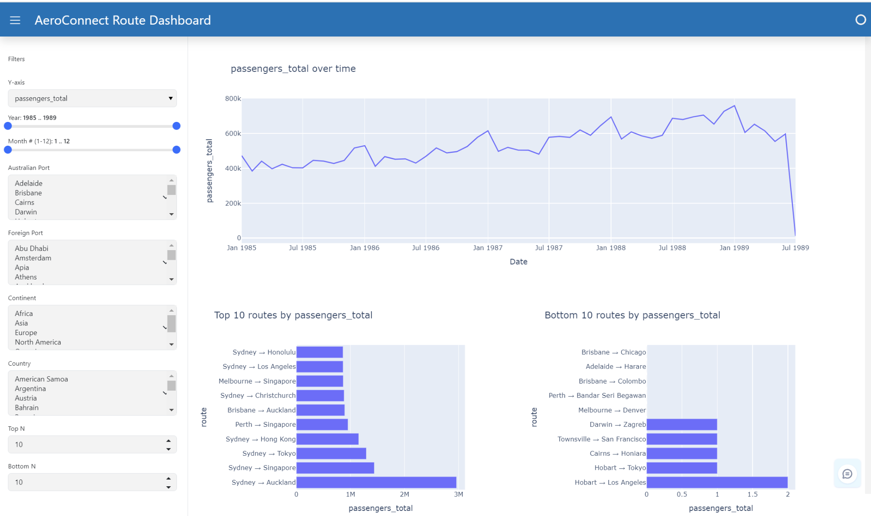
Dashboard Walkthrough
Used Panel and plotly.go for timeseries
Currently on default filters
Includes top n and bottom n totals
Will walkthrough live version

Slide 5

Model Selection
Linear Regression?
Chose SARIMA
Works well with seasonal data
Works with non-stationary data
Notes:
When I got to the modeling stage, I first thought about whether something simple like linear regression could work. The problem is that linear regression doesn’t really handle seasonality or repeating cycles well because it just tries to draw the best straight line through the data. That wouldn’t capture the general peaks in December and January or the dips in February that we clearly saw earlier.
So instead, I went with SARIMA. This model is built for time series data because it can handle seasonality really well, and it also works on non-stationary data, which is important since our dataset had an upward trend over the years. That combination made SARIMA the best fit to both capture the repeating yearly patterns and adjust for the overall growth in passenger traffic.

Slide 6
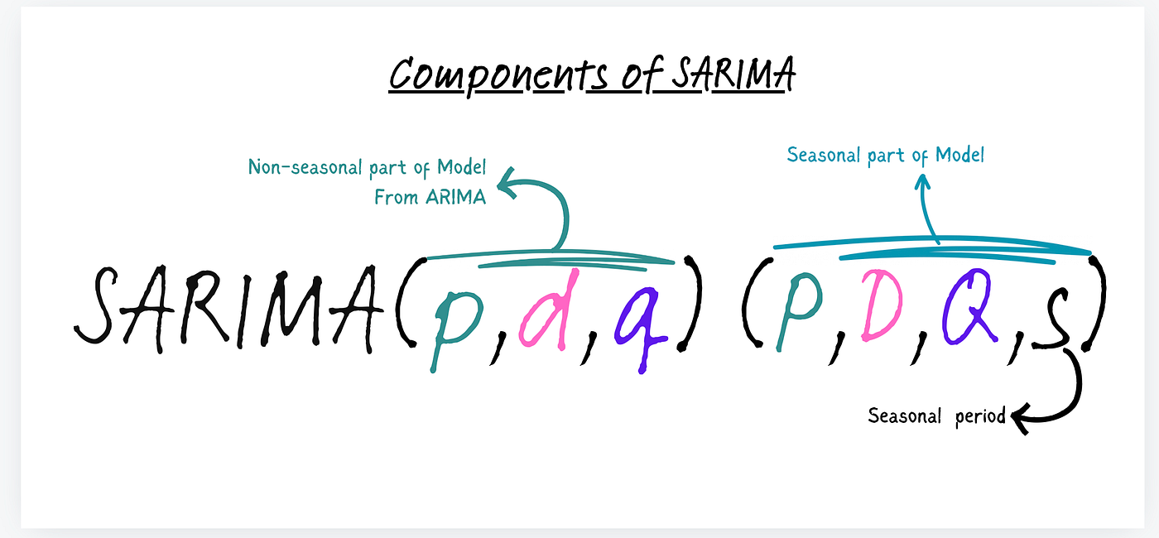
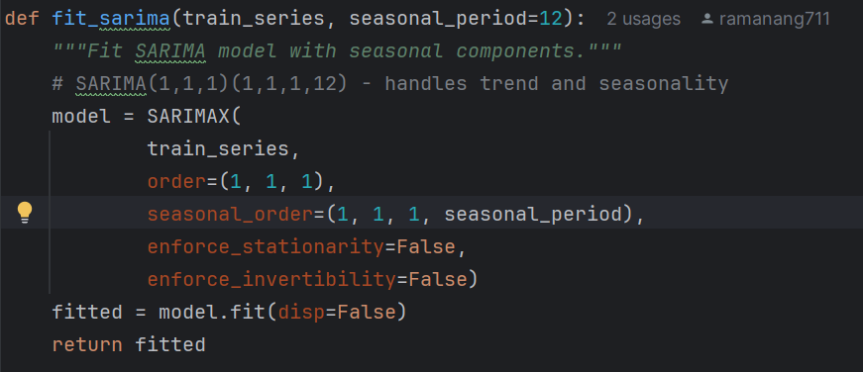
Model Implementation Justification
Non-seasonal parameters: (p=1, d=1, q=1)
Seasonal parameters: (P=1, D=1, Q=1, s=12)
1985 - 1988 data for training
1989 first 6 months for testing to find accuracy
Notes:
After choosing SARIMA, I had to decide on the parameters. For the non-seasonal part, I used (p=1, d=1, q=1). That means I included one autoregressive term, applied first differencing to remove the overall upward trend, and added one moving average term to capture residual error patterns.
For the seasonal part, I used (P=1, D=1, Q=1, s=12). This enabled the model to look back one year at a time, since the data is monthly and has clear yearly seasonality. In doing so, the model can capture the repeating local maximums and minimums across the same months annually. By including both seasonal autoregressive and moving average terms, it doesn’t just recognize these cycles but it also accounts for how past seasonal fluctuations might influence future values, making the predictions more reliable.
To train the model, I used data from 1985 through 1988, and then tested it on the first six months of 1989. That way I could evaluate how well the model predicts new data and get an actual accuracy measure.

Slide 7
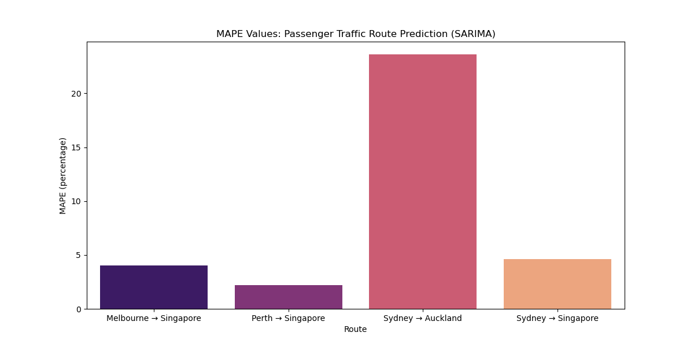
Model Results
Singapore Foreign Port showed best accuracy
Sydney and Auckland not too accurate (highest passenger traffic though)
Why?
Notes:
So when I tested the model, the Singapore routes consistently showed the best accuracy. For example, Melbourne–Singapore and Perth–Singapore both had really low MAPE values, in the 2–4% range, which means the model was almost spot on.
On the other hand, the Sydney ↔ Auckland route was much less accurate, even though it had the highest overall passenger traffic. The model really struggled here, giving a much higher error rate, over 20%.
The reason for this difference comes down to seasonal consistency. Singapore routes follow a very steady pattern year after year where the monthly peaks and dips happen reliably, which makes them easy for SARIMA to predict. Sydney and Auckland, however, are a lot more volatile. Their peaks and valleys don’t line up consistently across years, and 1989 in particular showed unusual fluctuations that the model couldn’t capture. To visually show this, let’s switch to my dashboard.
So essentially, the model works really well when the seasonality is stable, but breaks down when the demand is irregular.

Slide 8
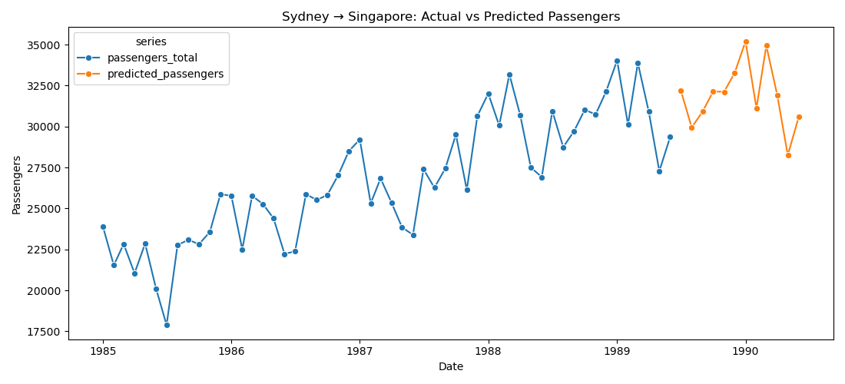
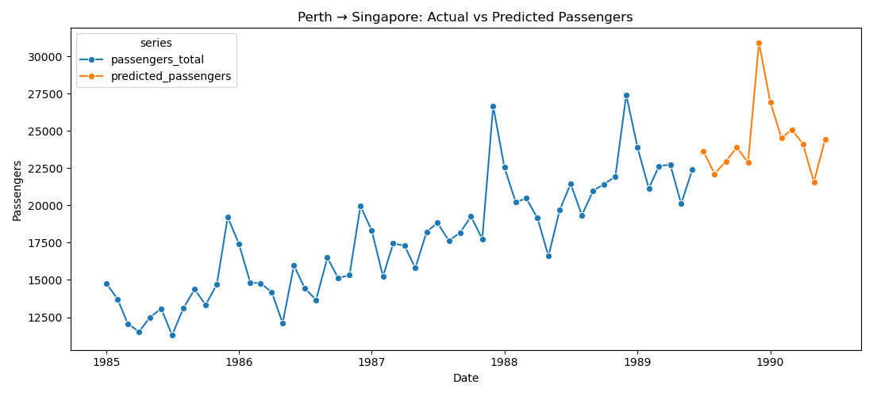
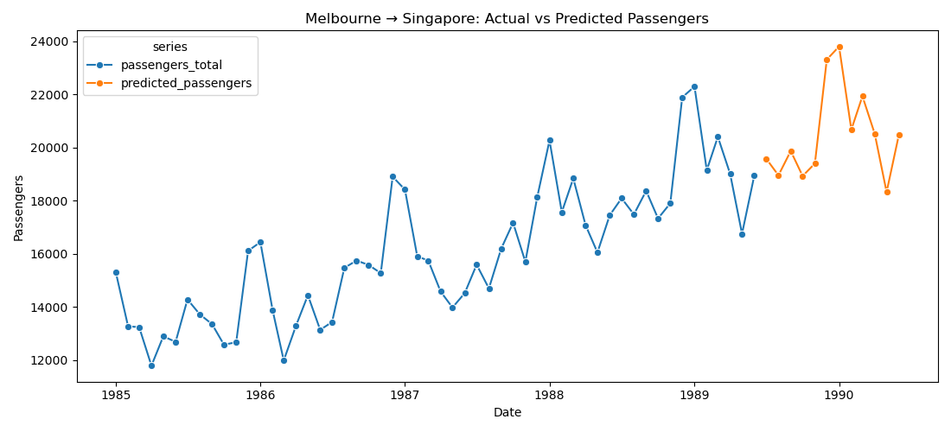
Forecasted Values

Slide 9

Recommendations
Invest in Singapore foreign routes
Scale back from Sydney and Auckland route
Use model for stable seasonal routes
Investment/Resourcing Decisions
Notes:
So based on what the model showed, the biggest takeaway is that Singapore routes are really consistent and predictable, so for AeroConnect, it makes sense to keep investing heavily there, especially the top three routes (Melbourne, Sydney, and Perth). On the other hand, the Sydney ↔ Auckland route is much more volatile, with peaks and valleys all over the place, so scaling back there could reduce the risk of loss even though it has the highest passenger traffic.
The model itself is especially valuable for routes that show stable seasonal patterns, regardless of the passenger traffic, because it predicts them almost perfectly. That means that AeroConnect can use it to make smarter investment and resourcing decisions such as how many pilots and cabin crew to schedule, how much catering to order, when to plan maintenance for flights, or even how to set promotions and marketing during low-demand months.

Slide 10
Done

